Slide 1
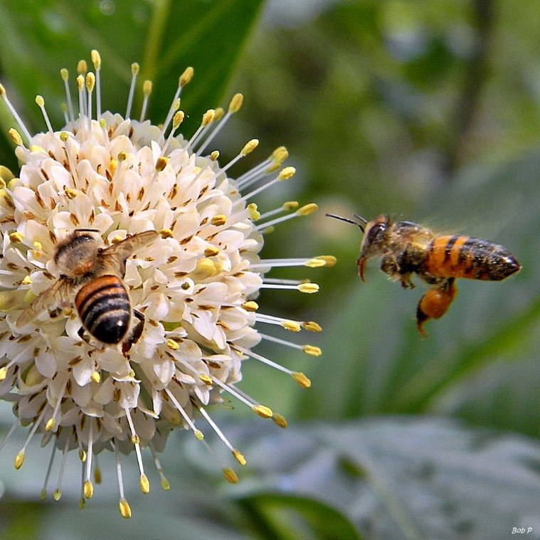
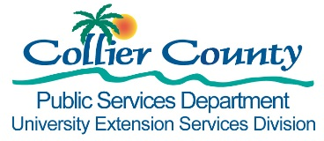


Honing the Honey Harvest
Isabel Way, Adapted From Roy Beckford
Presented by
Tom Becker, Residential Horticulture Agent

Slide 2
Topics
Major Nectar Plants
Minor Nectar Plants
Plants to Avoid
Pesticide Safety

Slide 3
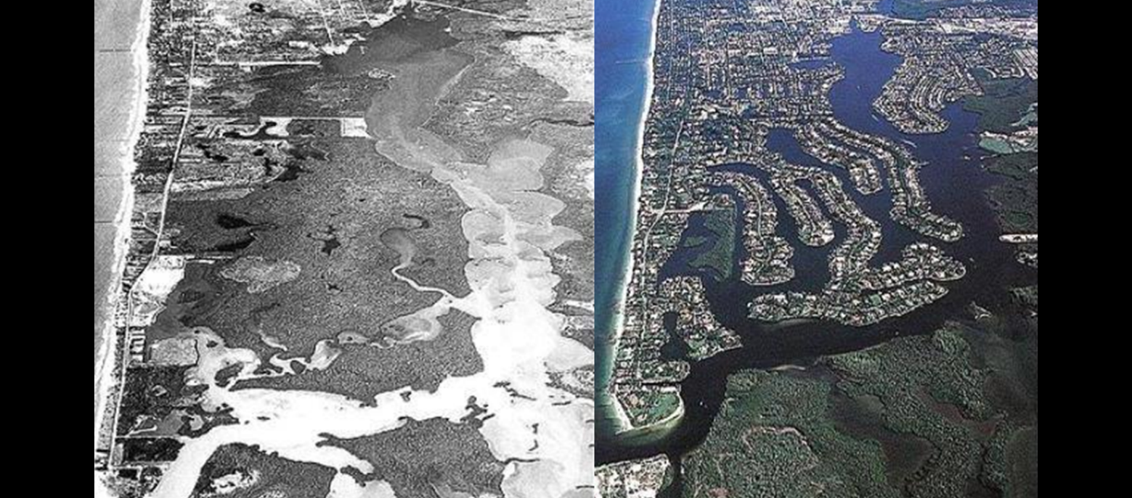
Decreasing Food Sources
Notes:
For the last 40 years, there has been an overall decrease in honey bee forage throughout the United States.
This is due to changing agricultural patterns and increasing urban development.

Slide 4
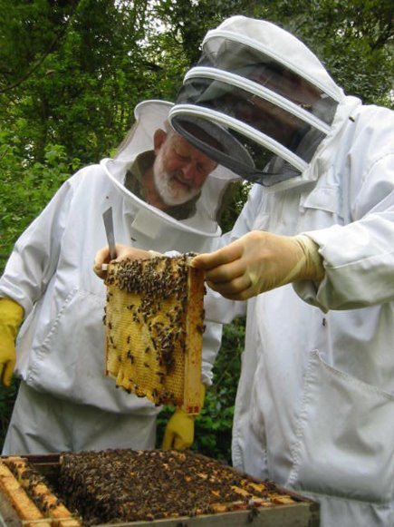
Pollen and Nectar species
In Florida less than ten species of plants account for over 90% of the state's honey crop
Only a few sites in the state support bees on a year-round basis.
Notes:
Many plants produce pollen for the bees, it is usually nectar-producing species that are of most interest to beekeepers.
Few plants are capable of secreting the vast amount of nectar honey bees need to produce a honey crop.
In Florida less than ten species account of over ninety percent of the state's honey crop, and only one, citrus, is cultivated.
It is known that soil and climate conditions vitally affect nectar flow in plants and therefore plants that will produce sufficient nectar flow in soma areas, will not prove satisfactory in other areas.

Slide 5
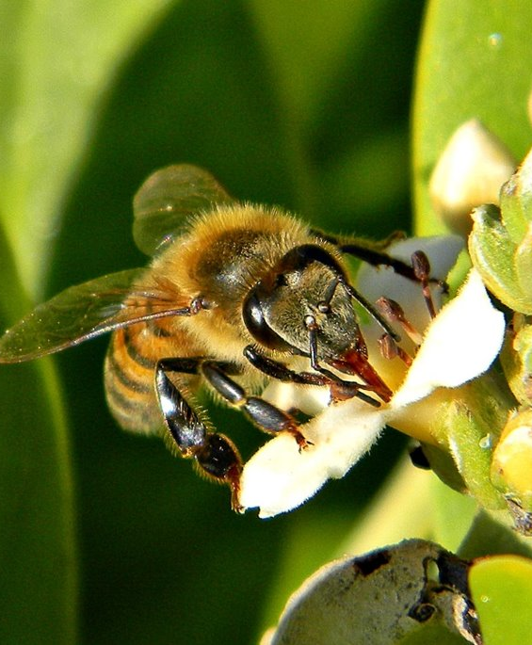
Major Nectar Plants

Slide 6
Nectar producers
The most reliable nectar producers are:
Black Mangrove
Brazilian pepper
Cabbage palm
Gallberry
Melaleuca
Saw palmetto
Citrus

Slide 7
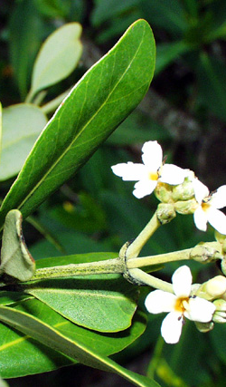
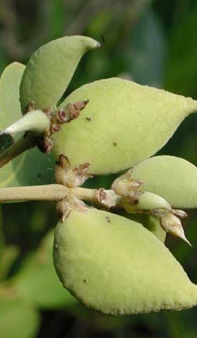
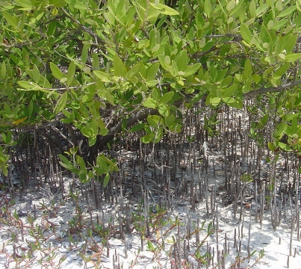
1. Black Mangrove
Avicennia germinans
One of the state's prime nectar sources.
Blooms in June and July, and produces surpluses almost every year.
The honey is white and prone to granulate quickly after extraction.

Slide 8
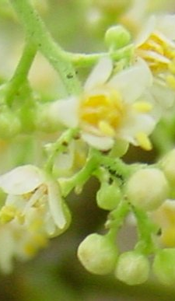
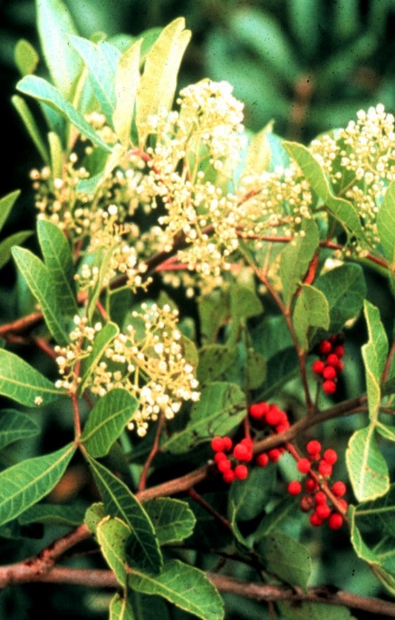
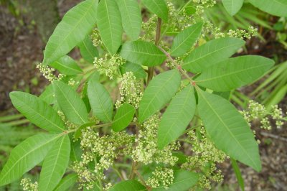
2. Brazilian Pepper schinus terebinthifolius
One of Florida's prime nectar producing plants.
It blooms August to October.
Invasive
The honey has a distinct "peppery" taste and is not considered by many to be table grade, but is accepted well locally.

Slide 9
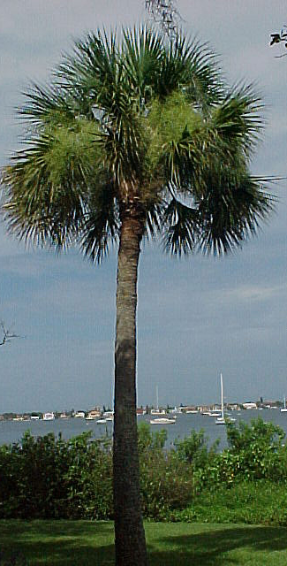
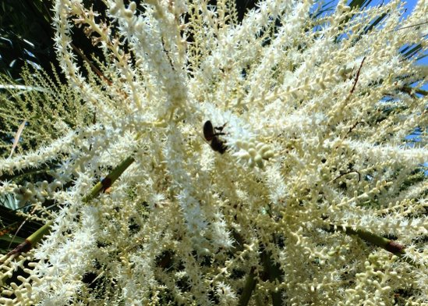
3. Cabbage Palm
Sabal palmetto
State tree of Florida
Bees usually produce nectar from cabbage palm in June and July, if summer rains do not interfere.
Photo: www.wghoney.com

Slide 10
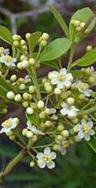
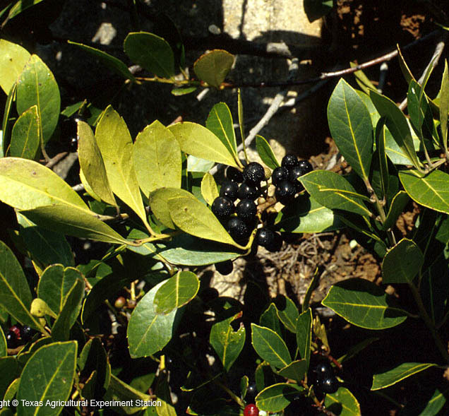
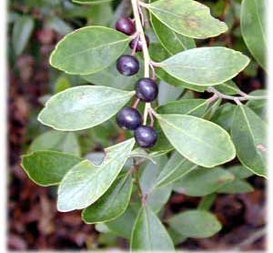
4. Gallberry
Ilex glabra
A common understory shrub of the flatwoods.
It occurs throughout the state and blooms March to May.
Prime but Threatened nectar source
Gallberry, present in vast blankets within low-lying swampy areas in the past, but continuously declining due to forest management procedures, agriculture and urbanization, all of which seek to drain the land and lower the water table.
Notes:
Gallberry honey is sourced from a small evergreen holly bush (also known as inkberry) that grows along the South Atlantic and Gulf Coast and produces a unique honey that is popular throughout the piney woods and swamps of southeast Florida.
It is desirable for the rich, elegant taste and is prized for its honeycomb. Its flavor is thick and aromatic, a perfect table honey, and also recommended for baking. Gallberry honey is known for its lack of granulation.
Gallberry honey is high in pollen and enzymes and therefore slow to crystallize. According to Florida beekeeper and National Honey Board member Doug McGinnis, this variety is a favored blending honey in Europe because it blends with other varietals and punches up the amount of diastase enzymes in the blend, preventing the honey from crystallizing even in cool temperatures. Gallberry is one of the highest honeys for diastase enzymes.
For a very short window of time every spring, from late April to early June, the bush blossoms with white flowers that drip nectar, providing beekeepers’ with their only opportunity to make the amber colored honey. Ideal production, according to beekeepers, occurs when the gallberry bush has “feet in water, head in sunshine.” As with any pure, single varietal honey, producing Gallberry honey takes the patience of an experienced artisan beekeeper because the bees must not be allowed to harvest nectar from any other flowering plant.
Unfortunately, this time-honored, local tradition is threatened by habitat loss to development throughout the area. Today, the untamed forests of the southeast where the plant is ubiquitous are rapidly being developed. Without this environment, the beekeepers of Southern Georgia and Northern Florida cannot continue to produce Gallberry honey. Doug McGinnis notes, that due “to destruction of wetlands, it’s harder to find areas that produce lots of gallberry honey. When I was young, the ‘galberry woods’ were most abundant just north of here, from Bunnell, Florida to Palatka, Florida. Today that area is encompassed by the Palm Coast development. So, sustainable? Only as long as we preserve some of the wild lands left in Florida and Southern Georgia.”
Single variety honeys and their bee colonies have yet to be affected by colony collapse disorder. Still, this increasingly widespread and mysterious disease is a danger and could put small, artisan and single-variety beekeepers out of business or cause them to turn to less sustainable, market-driven practices.

Slide 11
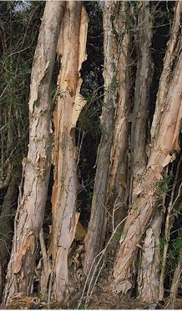
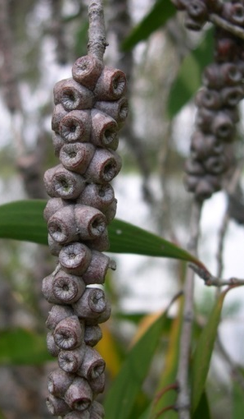
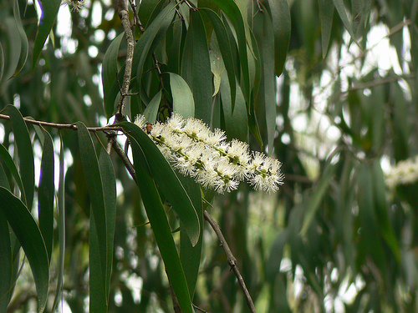
5. Melaleuca
Melaleuca quinquenervia
May bloom several times a year, assisting the bees during nectar shortage, and produces surpluses in August.
The nectar is considered distasteful by some.

Slide 12
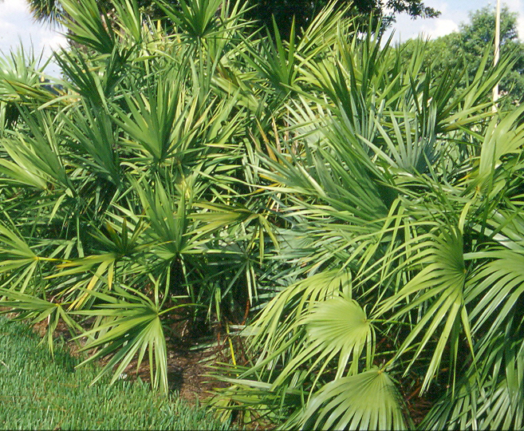
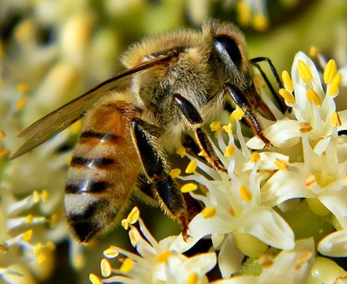
6. Saw Palmetto
Serenoa repens
One of Florida's prime nectar sources and has a reputation for producing surplus honey crops.
Blooming April-June
The honey is light green to amber and often has a high moisture content.
Photo by Bob Peterson
Notes:
Occurs statewide in hammocks, flatwoods, scrub, sand dunes, and in the landscape

Slide 13
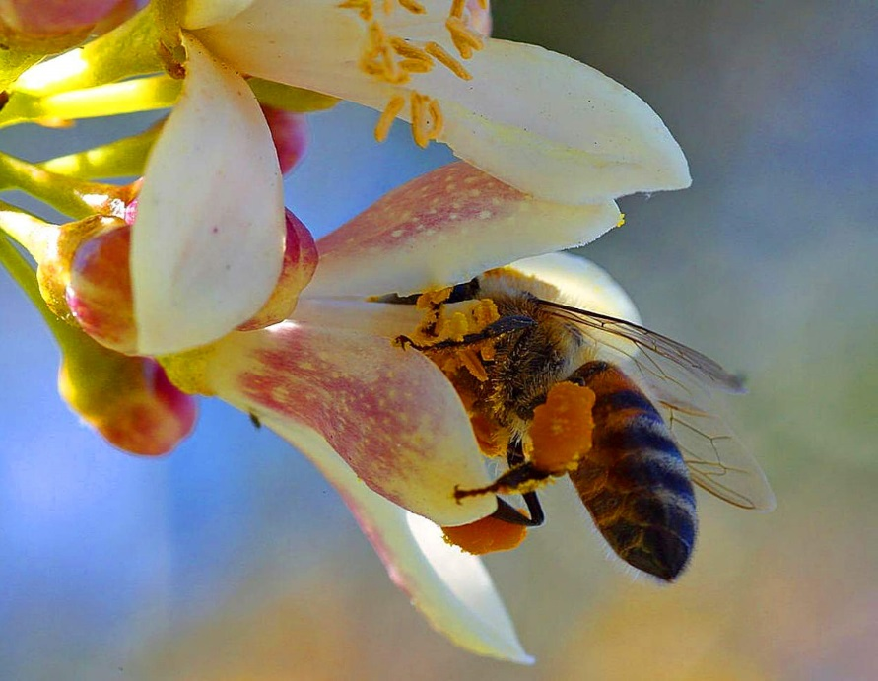
7. Citrus
Orange produces more nectar
Honey is clear and light in color and has a pleasant flavor
Photo by Bob Peterson

Slide 14
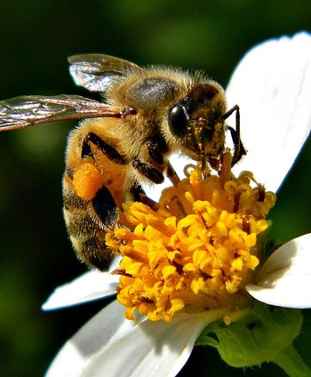
MINOR
NECTAR
PLANTS

Slide 15
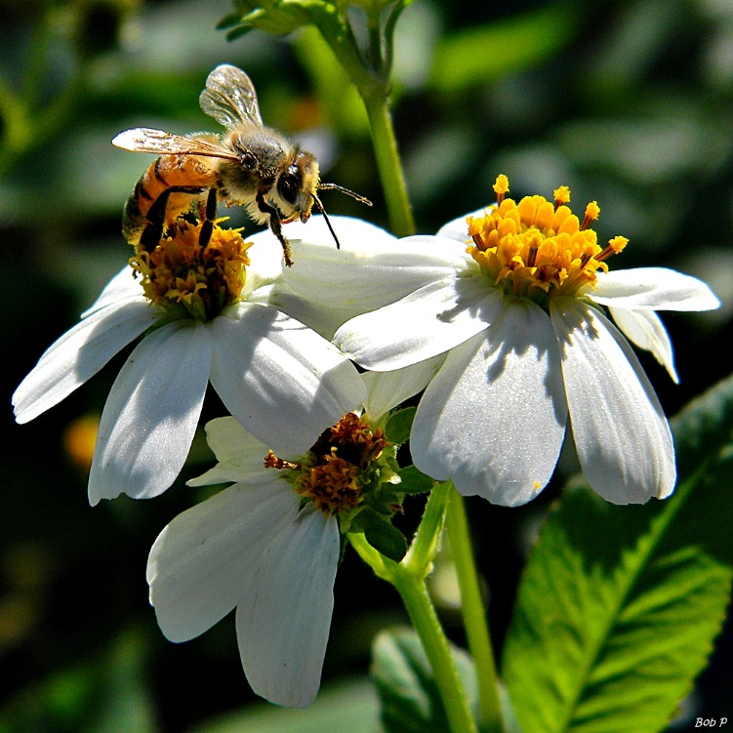
Spanish Needles
Bidens alba
Photography by Bob Peterson
Notes:
Most important food source for native bees
Honey: reddish, thick, fragrant, smooth, mild flavor

Slide 16
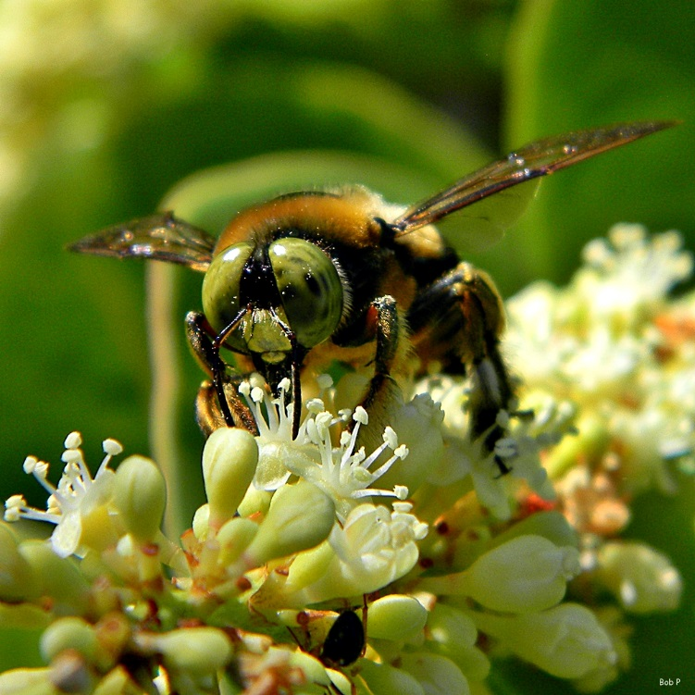
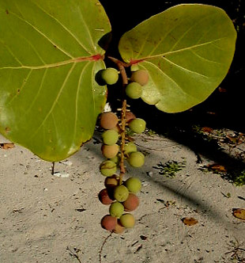
Seagrape
Coccoloba uvifera
Photo by Bob Peterson
Notes:
Flowers on and off throughout the year
Honey is spicy and light in color and has a high moisture content. The plant can be dependent upon to produce nectar with fair regularity

Slide 17
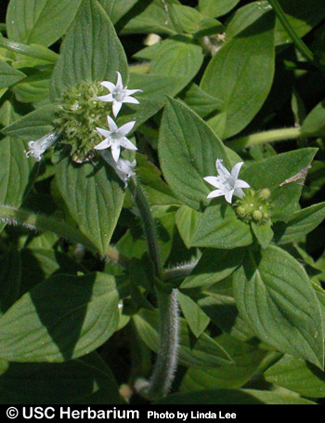
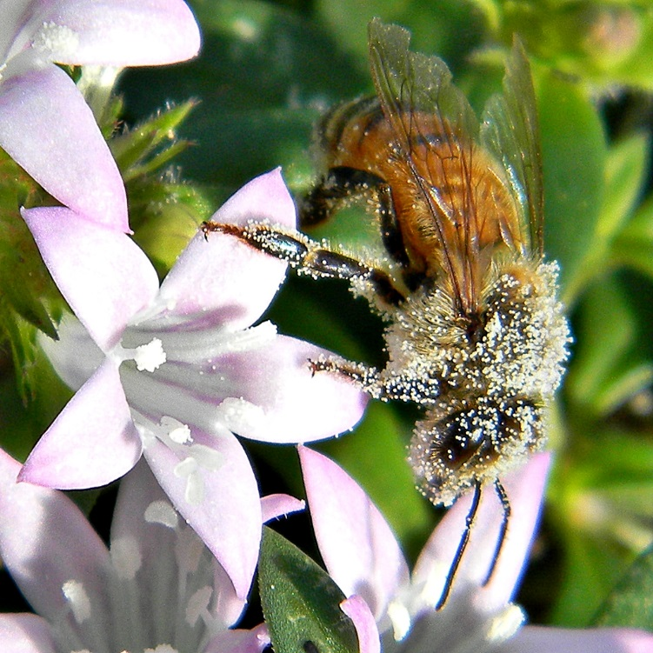
Mexican Clover (Pusley)
Richardia grandiflora
Photo by Bob Peterson
Notes:
Helps the colony with reserves for overwintering

Slide 18
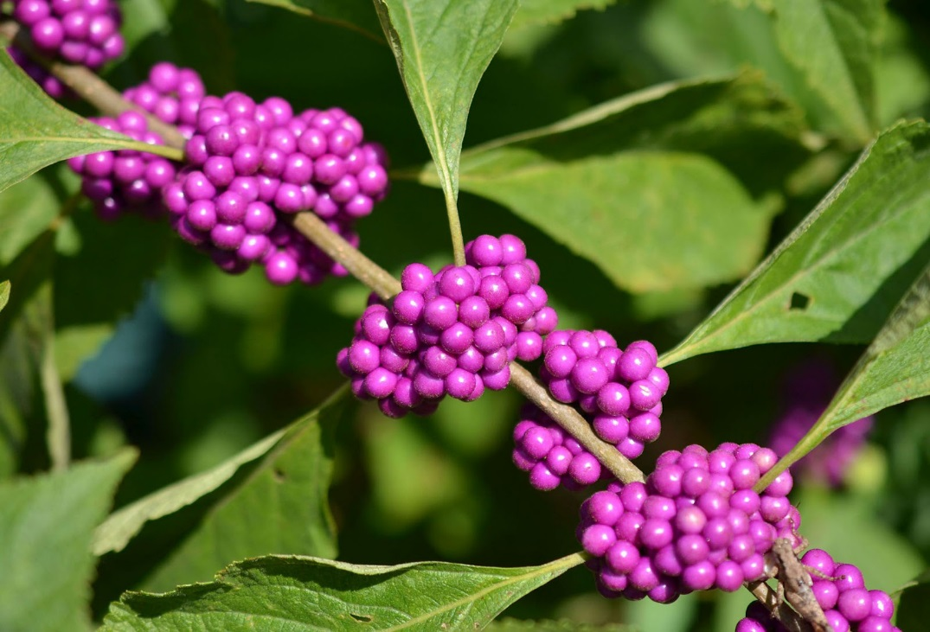
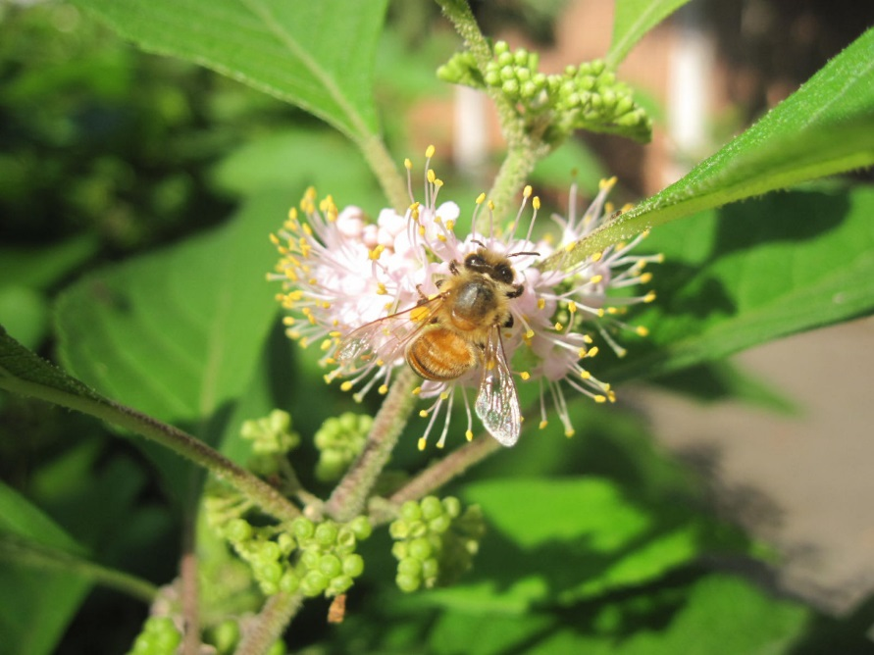
American Beautyberry
Callicarpa americana
Notes:
Has a good nectar flow. More used in landscapes

Slide 19
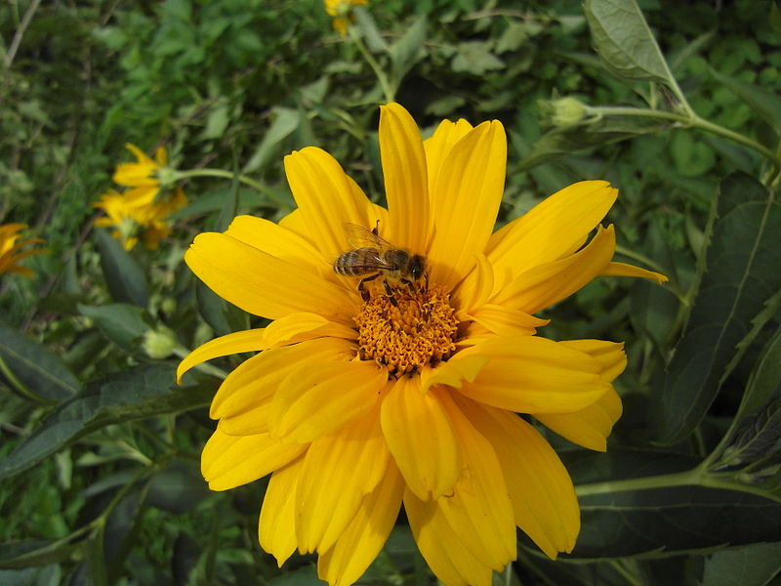
Prairie Sunflower
Notes:
Honey useful as food for colony when other food sources are scarce.

Slide 20
Minor Nectar Plants Used in Urban Landscapes
Gumbo Limbo
Pigeon Plum
Buttonwood
White Stopper
Dahoon Holly
Wax Myrtle
Liveoak
Mastic
Mahogany
Cocoplum
Gopher Apple
Lantana
Cat’s Claw
Elderberry
Necklace Pod
Blackeyed Susan
St Augustine Grass (pollen)
Blue proterweed
And many more…..

Slide 21
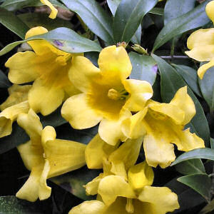
Undesirable Plants
Plants that harm bees

Slide 22
Yellow Jessamine
Gelsemium sempervirens (L.)
Native
Blooms February to March.
Reported toxic to honey bees and responsible for reducing colony strength in some areas.

Slide 23
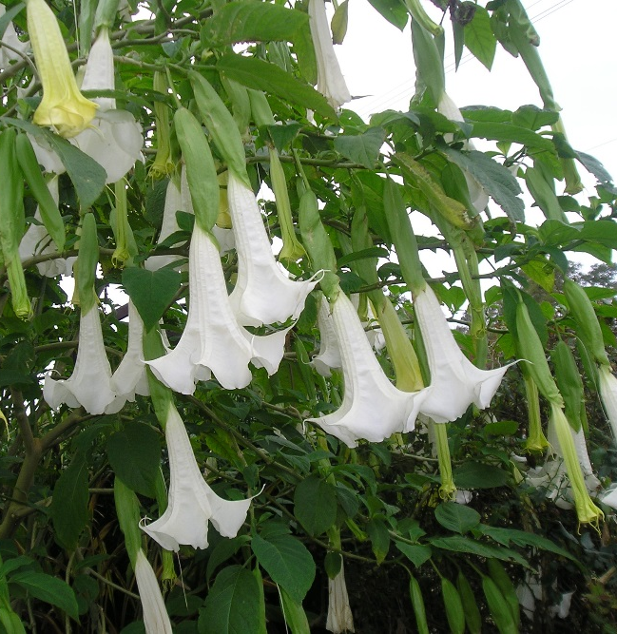
Angel’s Trumpet
Brugmansia spp.
Though ornamental and sweet smelling, the trumpet flower’s nectar can cause brood death in bees and is best avoided.

Slide 24
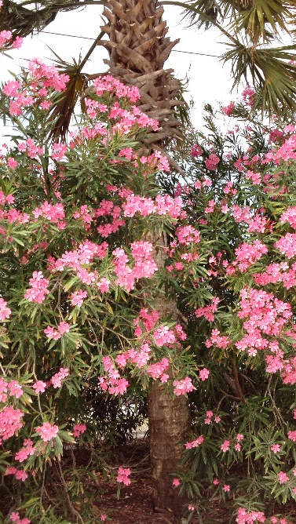
Oleander
Nerium oleander
Harmful to butterflies as well as bees, oleander has a severe effect on hives. Nectar taken to the hive concentrates as it dries out, which increases the amount of toxins and usually results in a mass hive wipeout.

Slide 25
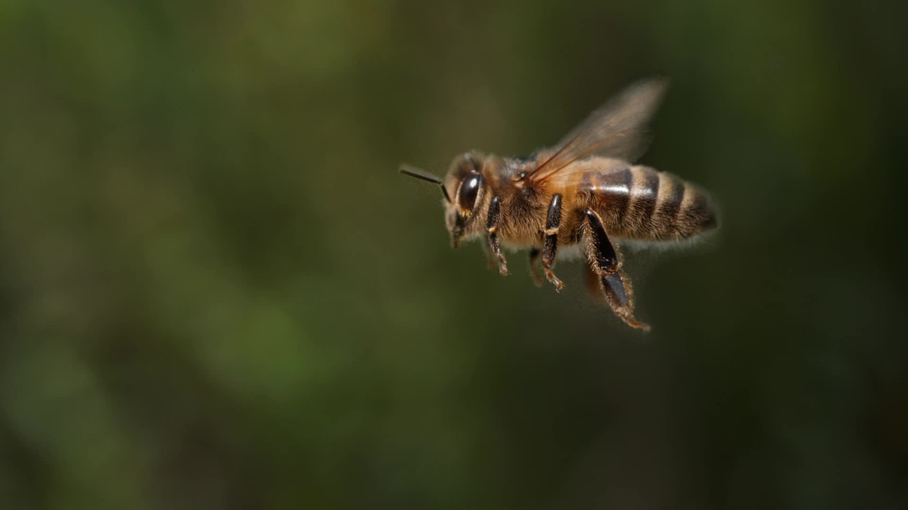
Bees and Pesticides
What can you do?
Adapted from J. D. Ellis, J. Klopchin, E. Buss, F. M. Fishel, W. H. Kern, C. Mannion, E. McAvoy, L. S. Osborne, M. Rogers, M. Sanford, H. Smith, P. Stansly, L. Stelinski, and S. Webb

Slide 26

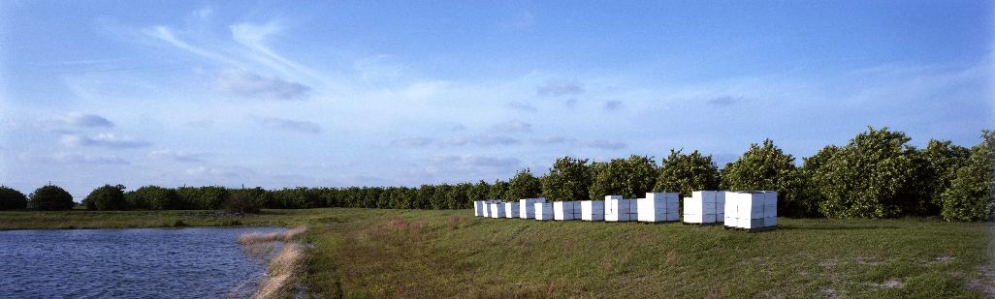
Pollinators and Pesticides
Potential exposure of bees to pesticides can vary greatly depending on the type of pesticide, formulation, application method, label restrictions, and other factors.
The goal in using a pesticide is to achieve maximum benefit (success) with minimum negative impact.
Credit: Florida Department of Agriculture and Consumer Services

Slide 27
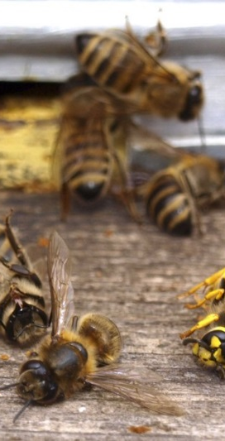
Routes of Exposure: Outside the Hive
Exposure is most likely to occur during foraging hours and at points of contact (foliage, pollen, nectar, water, and propolis).
Direct application (spray, dusting etc.) to foliar surfaces or exposed nectar/pollen creates an immediate route of exposure.

Slide 28
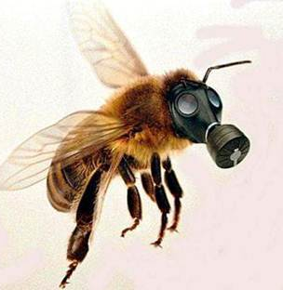
Routes of Exposure: Outside the Hive
Systemic pesticides, which are incorporated into plant tissues, may expose field bees and hive bees to pesticide-laced foliage, nectar, pollen, and possibly propolis.

Slide 29
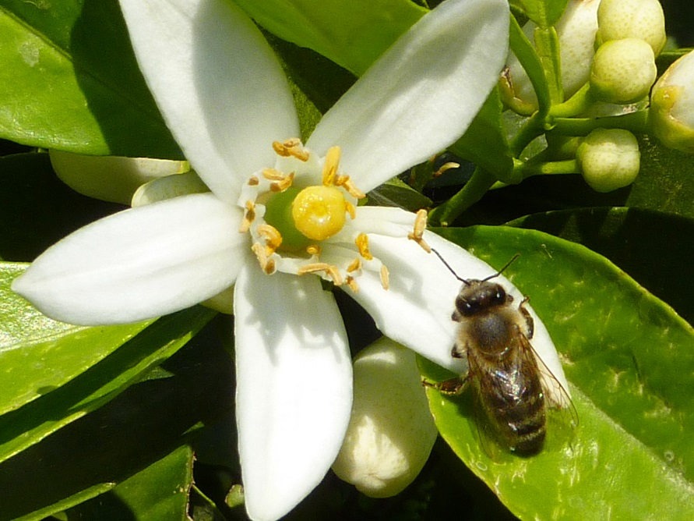
Routes of Exposure: Outside the Hive
Bees can die of acute toxic exposure before returning to the nest or chronically by carrying pesticide residues back to the nest which may produce long-lasting, sub-lethal effects.

Slide 30
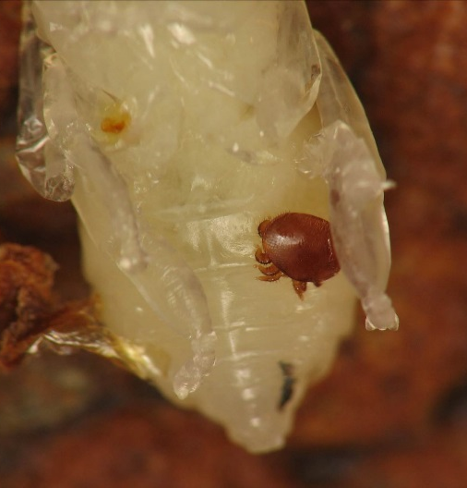
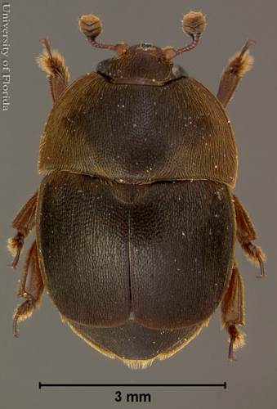
Routes of Exposure:
Inside the Hive
Pesticides are used to treat invading insect pests, parasites, and pathogens of bees such as small hive beetle and Varroa mites.
Credit: Lyle Buss
University of Florida
Credit: Jason Graham
University of Florida
Notes:
Residues of many in-hive applied pesticides have been detected inside hive components, resulting in both acute and chronic bee exposure.
coumaphos — organophosphate
tau-fluvalinate — pyrethroid
amitraz — formamidine
formic acid, hop beta acids, and thymol

Slide 31
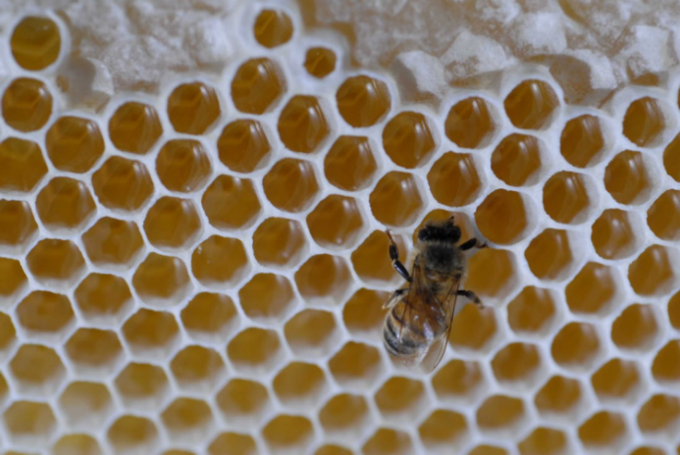
Pesticide Integration into the Hive
Digestion of contaminated bee bread and honey can lead to contaminated secretions of wax and royal jelly.
Wax slows the degradation of some compounds, potentially increasing the exposure of bees to pesticides.
Credit: University of Florida
Credit: James Hill
University of Florida

Slide 32
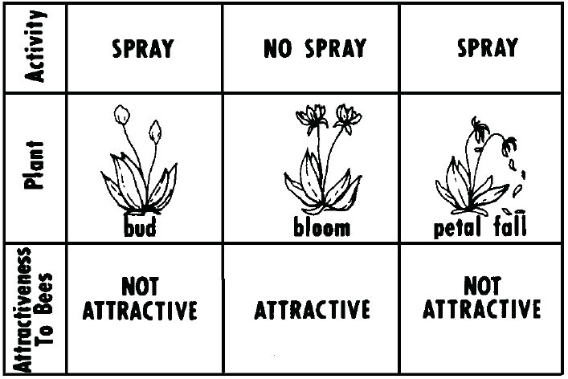

Slide 33
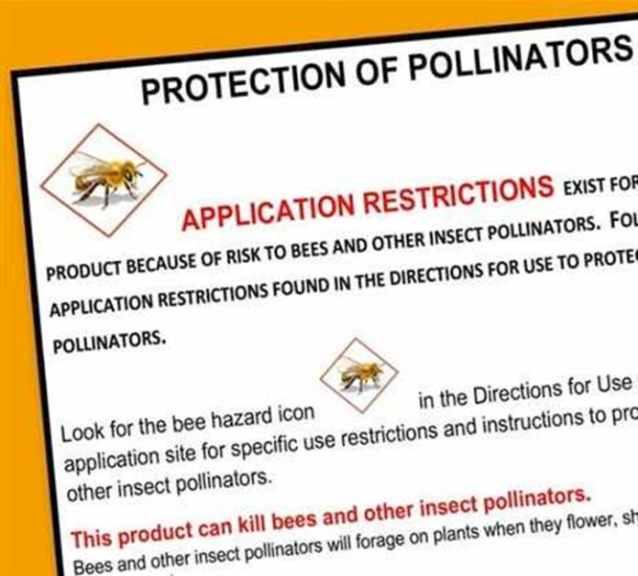
Pesticide Regulations
Pollinating Insect Hazard Statement
  If a pesticide is used outdoors as a foliar application, and is toxic to pollinating insects, a “Bee Hazard” warning generally has been required to be included in the Environmental Hazards.

Slide 34
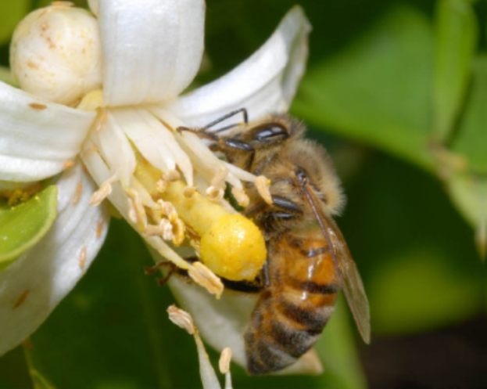
Pollinator Language on Pesticide Labels
Read the pesticide label and interpret the meaning of label wording.
An environmental hazards statement is included on the label.
  precautionary language - from transport, use, storage, or spill of the product
A pollinating insect hazard statement is included on the label.
  Examples of the statement include: “toxic,” “highly toxic,” “potentially toxic,” etc.
The label also includes information on:
  other non-target organisms affected and
  a bee hazard statement.
Credit: HBREL
University of Florida

Slide 35
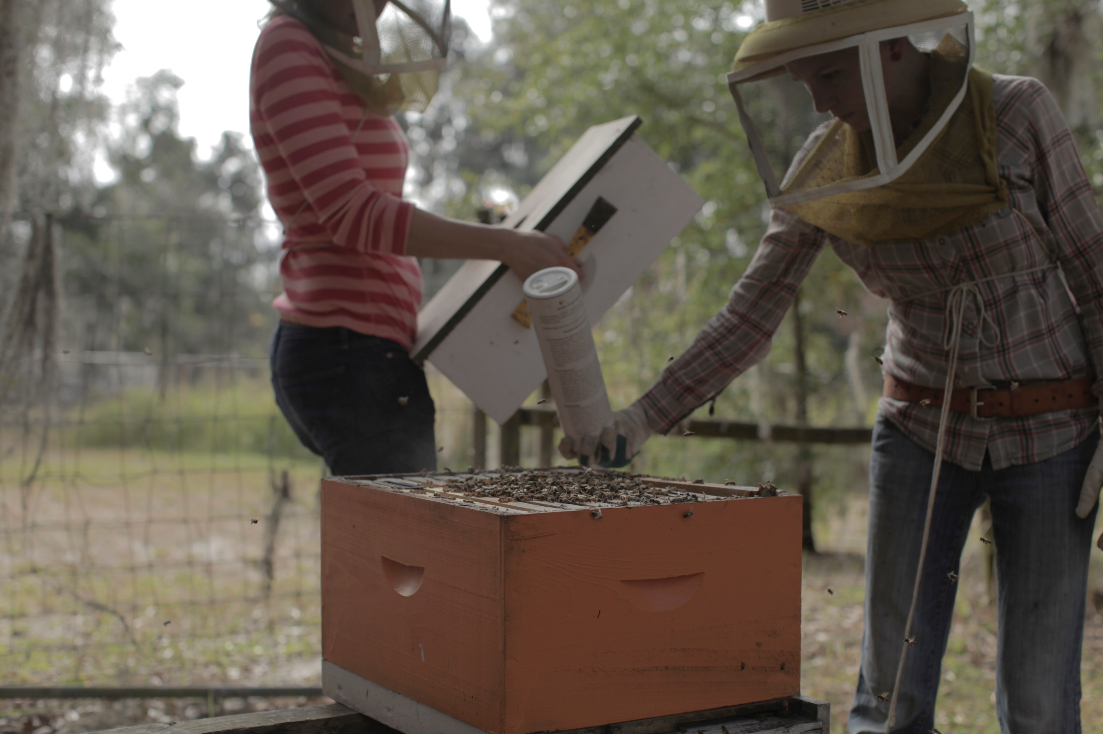

Risk Reduction Approaches for Beekeepers
Develop and maintain one-on-one communication with growers whose crops your bees are pollinating or from which they gather nectar for honey production:
Have written agreements with the grower.
Maintain open communication with the grower.
Understand grower pesticide use habits.

Slide 36
Risk Reduction Approaches for Beekeepers
Do not place hives in/near crops without an agreement.
Be a good partner to the grower; be flexible, informative, understanding.
Recognize the colony’s total foraging area and the at-risk regions within the foraging area.
Understand the farm and crop dynamics of pollination/honey production sites.

Slide 37
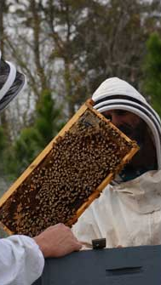
Hive Management
Adopt IPM practices to control hive pests.
Follow pesticide label directions when treating.
Be ready to relocate colonies when necessary.
Monitor colony health frequently.
Keep colony health logs.
Credit: Sean McCann, University of Florida

Slide 38
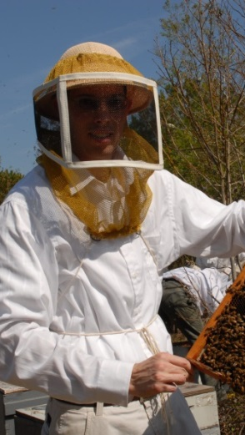
Hive Management
Notes on on-crop hive placement:
  Do not place colonies on crops until abundant early bloom.
  Remove colonies promptly when abundant bloom ends.
  Choose the least hazardous site to locate the bees.
  Avoid crop pest management times.
Credit: HBREL, University of Florida

Slide 39

Recognizing Mortality Due to Pesticide Exposure
  There is an immediate lack of foraging bees. Foraging bees may become disoriented, thus producing a general reduced foraging efficiency.
  There are large numbers of dead, crawling, and walking bees at the hive entrance or intense fighting at the hive entrance.
  Confused bees are moving rapidly.
  Bees may be spinning on their backs.
  Bees may appear to be “chilled.”
  Bees can become irritable (likely to sting), paralyzed, or exhibit other abnormal behavior.

Slide 40
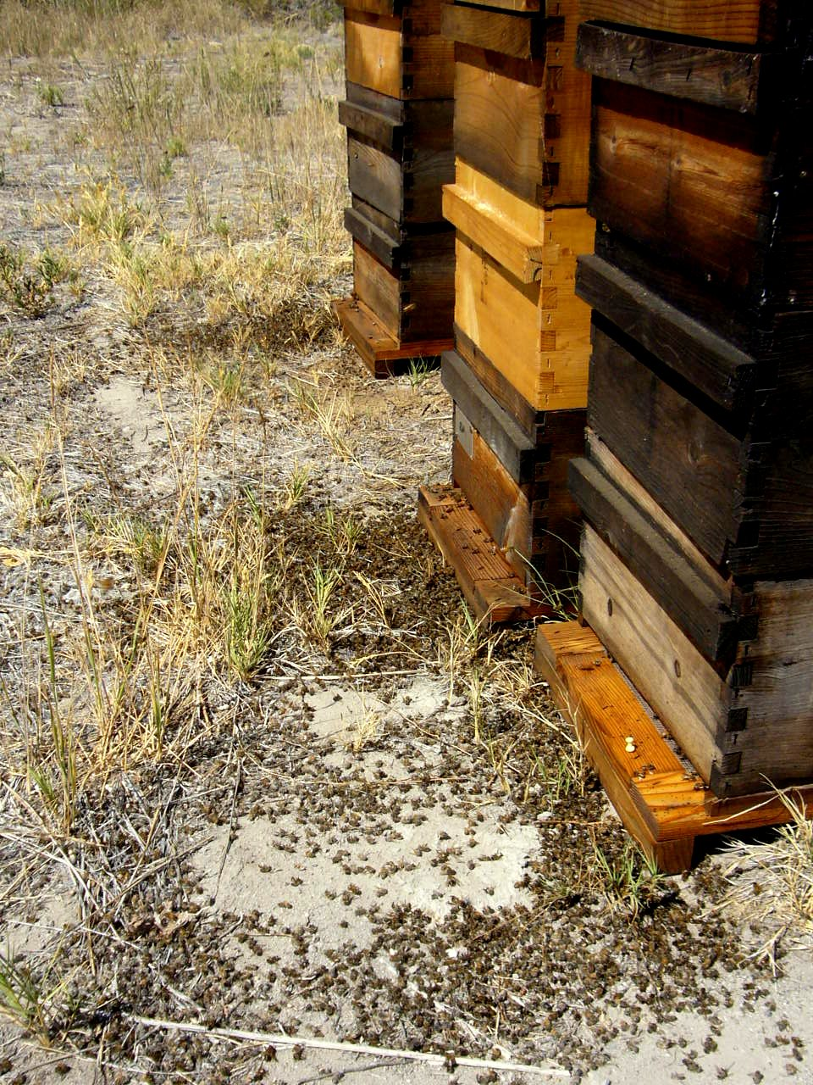
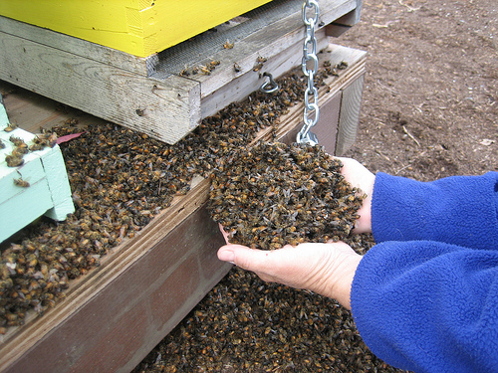

Examples of Bee Kills
California
Credit: Hayes Valley Farm
Florida
Credit: FDACS
Nevada
Credit: Randy Oliver

Slide 41
Reporting Bee Losses
  All suspected exposure cases should be reported immediately to the FDACS-DPI Apiary Inspection Services.
  One should collect:
  photos, video, other evidence of poisoning,
  possible exposure details, location of kill, weather conditions, etc.,
  possible product used, EPA registration number,
  dead/dying bees (1 cup or more), and
  2 × 2 inch piece of comb containing pollen.
  The bees and hive components should be collected by a 3rd party (e.g. FDACS Apiary Inspector) for reporting to the FDACS or EPA.

Slide 42
Collier County Mosquito Control District
https://cmcd.org/spray_maps/?notify

Slide 43
References
Arnold, Lillian. 1954. “Some Honey Plants of Florida,” University of Florida Agricultural Experiment Bulletin 548, Gainesville, FL. 47pp.
Morton, Julia. 1964. “Honeybee Plants of South Florida,” Proceedings of the Florida State Horticultural Society, Vol 77:415-436.
Sanford, Malcolm T. 2003. “Beekeeping: Florida Bee Botany,” Institute of Food and Agricultural Sciences, University of Florida CIR 686, Gainesville, FL. 5pp.
Ellis, J. D., and J. Hayes. 2008. Mosquito Control and Beekeepers. EDIS #ENY-149. http://edis.ifas.ufl.edu/in813. 3 pp.

Slide 44
References
EPA. 2012. Pollinator Risk Assessment Framework Agency White Paper. http://www.regulations.gov/#!documentDetail;D=EPA-HQ-OPP-2012-0543-0004.
Hooven, L., R. Sagili, and E. Johansen. 2013. How to Reduce Bee Poisoning from Pesticides. Pacific Northwest Extension Publication, PNW 591, Oregon State University, University of Idaho, Washington State University, 35 pp.
Johnson, R. M., M. D. Ellis, C. A. Mullin, and M. Frazier. 2010. Pesticides and honey bee toxicity – USA. Apidologie, 41:312-331. DOI: 10.1051/apido/2010018.
Mullin, C. A., M. Frazier, J. L. Frazier, S. Ashcraft, R. Simonds, D. vanEngelsdorp, and J. S. Pettis. 2010. High levels of miticides and agrochemicals in North American apiaries: implications for honey bee health. PLoS One 5: e9754. doi:10.1371/journal.pone.0009754.

Slide 45
Resources
Florida Bee Protection Website: http://www.freshfromflorida.com/Consumer-Resources/Florida-Bee-Protection - The Florida Department of Agriculture and Consumer Services (FDACS) has developed a website that beekeepers and growers can use a resource on the issues of bee and pesticide interactions.
FDACS Apiary/Citrus Management/Bee Forage Map: http://www.freshfromflorida.com/Divisions-Offices/Plant-Industry/Agriculture-Industry/Apiary-Inspection/Florida-Apiary-Citrus-Industry-Link-Mapping-Service.
FDACS Apiary Inspection Service website: http://www.freshfromflorida.com/Agriculture-Industry/Search-by-Industry/Bees-Apiary/Apiary-Inspection - The head office is in Gainesville, though there are 10+ apiary inspections who live throughout the state. They are your local experts on this topic. They are, in fact, the first on site to inspect colonies believed to have been exposed to pesticides. You can find out more about the program and your local inspector at the linked site.
U.S. EPA Pollinator Protection site: http://www2.epa.gov/pollinator-protection - The EPA is establishing new guidelines regarding pesticide labels, and risk assessment tests for pollinators. They have developed a website where they house all of their information, including the “new risk assessment guidance for pollinators” http://www2.epa.gov/pollinator-protection/pollinator-risk-assessment-guidance. The EPA has specific information about neonicotinoids and pollinators found here: http://www2.epa.gov/pollinator-protection/new-labeling-neonicotinoid-pesticides

