Slide 1
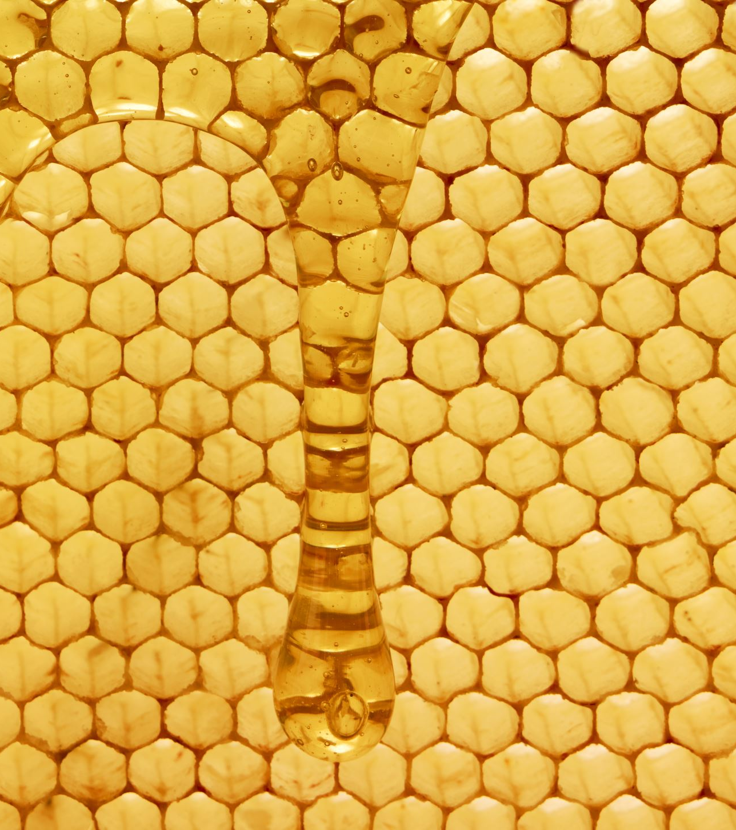
Honey Extraction
How and When to Remove Supers

Slide 2
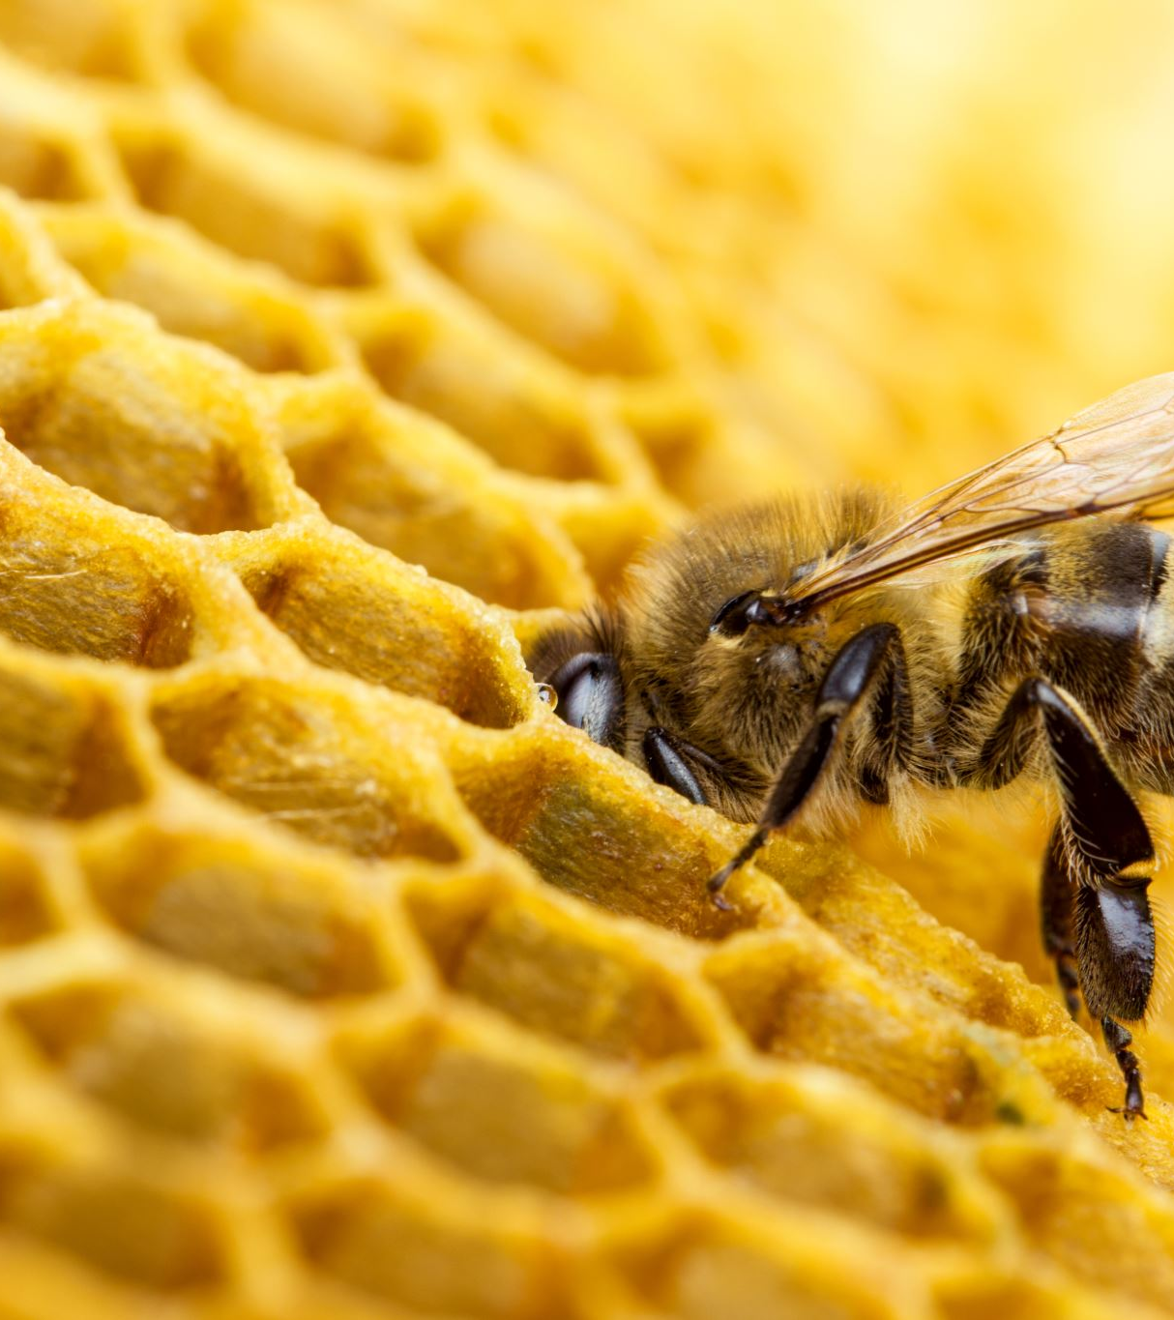
How and When do I get “Surplus” Honey?
Honey bees do not hibernate, they are active even during cold spells
Honey bees put honey away for later use during winter as they often cannot find a food source in the winter months.
It is important to leave enough honey in the hive for the bees to survive the winter season, they often consume 60 to 90 pounds of honey during this time.

Slide 3
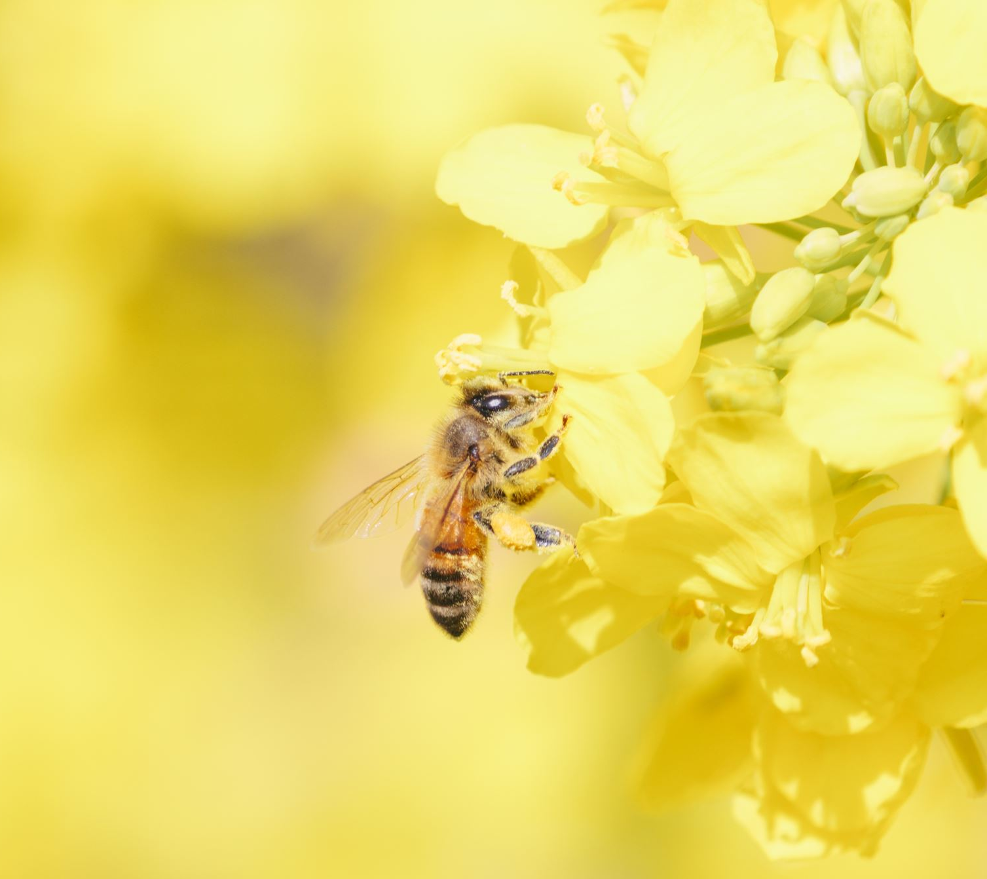
When is it Time to Remove the Honey?
Honey can be removed from a hive almost anytime provided that the honey is fully capped over.
“Capped over” means that more than 7/8ths of the frame is capped.
Uncapped (unripe) honey will ferment & spoil if you harvest it, too much moisture.
Personal preference as to how often you remove supers/honey.
Some Beekeepers remove honey once a year while others remove honey after each major nectar/pollen flow
Make sure you leave enough honey for your hive to survive winter.
Patience is a virtue!

Slide 4
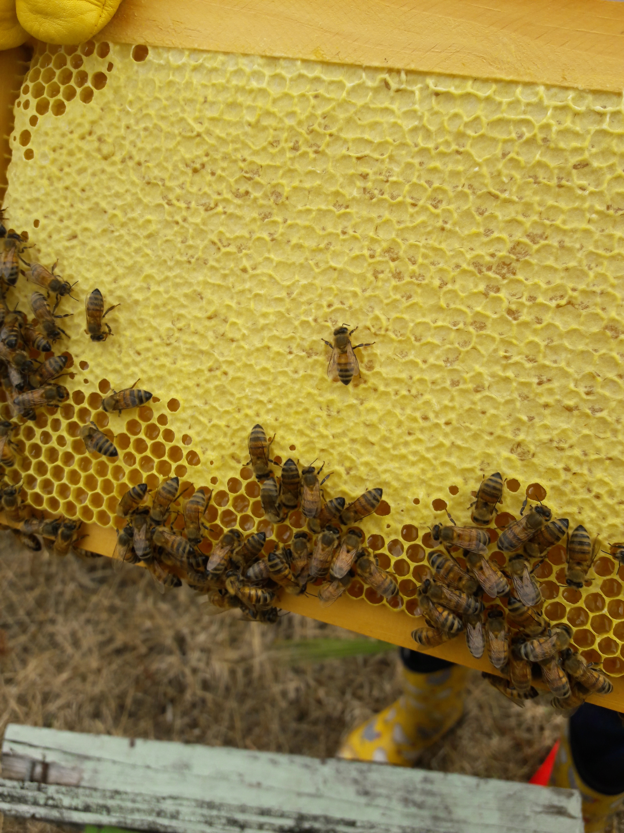
Capped Honey
Uncapped Honey

Slide 5
How to take Honey Supers off the Hive
Bee Escapes
Bee escapes are a one-way exit that allows the bees to leave a super and prevent them from re-entering.
Bee escapes are placed on the hole of the inner cover. The cover is then moved under the super you are wishing to remove. Wait a few days until the bees leave the super, and then remove it.
This method works best on cooler days.

Slide 6
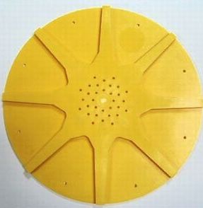
8-way bee escape

Slide 7
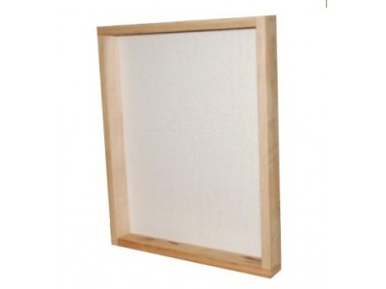
How to take Honey Supers off the Hive
Fume Boards
Fume boards use a liquid chemical to drive bees from the honey super.
Fume boards are a cloth, top cover placed on top of the supers you wish to extract. The chemical is sprinkled on the cloth board and helps push the bees out of the honey super as the odor is repulsive or “pungent” to the bees.
This method pushes the bees out of a honey super in 3 to 5 minutes. If left on too long, it can push the bees out of the hive completely.

Slide 8
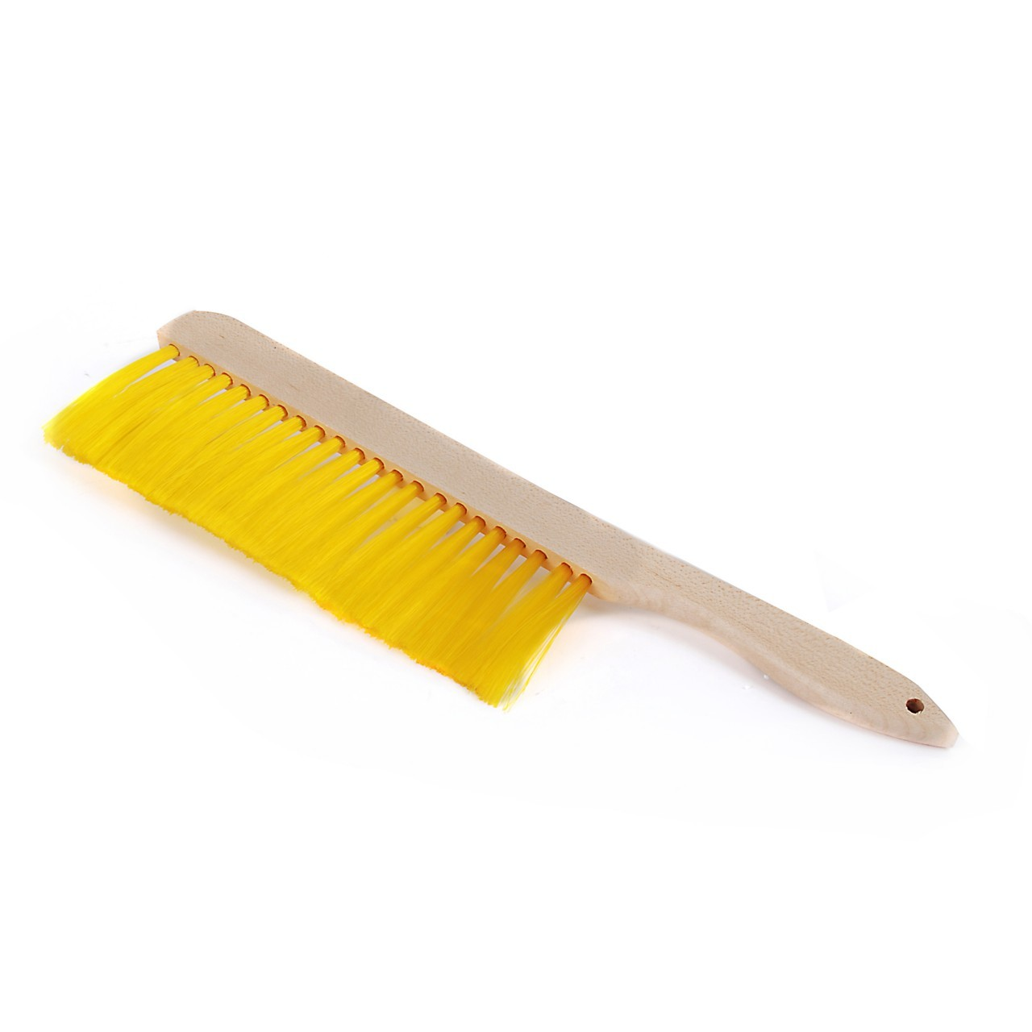
How to take Honey Supers off the Hive
Brush
When using a brush it is important to roll your wrist
You want to flick the bee’s off the frame, not scrub them off
You always want to brush the bee’s “up”
This prevents them from getting stuck in uncapped honey or injured

Slide 9
Honey Extraction Video
Honey Extraction - YouTube

