Slide 1

Selling Honey Under the Cottage Food Law
FDACS Cottage Food Law
UF is an equal opportunity employer​

Slide 2
What is the Cottage Food Law?
In 2011, The Florida Legislature passed HB 7209 which allows for individuals to make, sell, and store ‘cottage foods’ with no requirement for licensing or permitting from the Florida Department of Agriculture and Consumer Services (FDACS) http://leg.state.fl.us/statues/
A limited list of cottage foods that are not “Potentially Hazardous Foods,” including honey (bottled or cut comb)
Prepared and packaged by an individual at their residence
The State does not require inspection, unless a complaint is made.

Slide 3
What are the Limits?
Sales up to a gross of $250,000 annually (2021)
May sell, offer for sale, and accept payment over the internet or by mail order
Products may be delivered in person directly to the consumer, to a specific event venue, or shipped across state lines by the United States Postal Service or commercial mail delivery service.
Products may be sold at farmer’s markets, pop-up markets, flea markets, and roadside stands (provided there are no other food items at the stand that require a food permit).
No consignment or retail store sales
No restaurant sales
No wholesale

Slide 4
Additional Requirements for Honey
The processor ( a.k.a. the one who does extraction and bottling) must also be the one who harvested the honey.
You CANNOT extract and/or bottle honey that was harvested by others under cottage food.

Slide 5
Label Requirements
Honey must be packaged—bottled or cut-comb in a container—and the label must include:
1. Name of Product
2. Name & address of cottage food operator
3. Ingredients
4. Net Weight

Slide 6
Label Requirements (cont.)
5. Allergen Information Since honey is not considered an allergen, but it has been associated with infant botulism, it is recommended to include: “Do not feed to infants less than one year old”
6. And the statement:
“Made in a cottage food operation that is not subject to Florida’s food safety regulations”
* Statement must be in at least 10 point font, and in a color that provides clear contrast to the background of the label
Visit FDACS website for specific label requirements

Slide 7
Local Regulation
Florida’s Cottage Food regulations does not exempt you from tax laws and local level regulator requirements.
In Collier County, you may be required to have:
• Business Tax Receipt License (from the Collier County Tax Collector’s office)
• Home Occupation zoning certificate (from the Growth Management office)
• If using a business name, you need to file a “Doing Business As” with the Florida Division of Corporations.

Slide 8
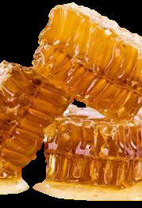
Descriptors
Avoid any nutritional claims or health related statements on the label
Natural or Pure
Raw
Organic
  https://www.ams.usda.gov/services/organic-certification/becoming-certified
Plant source
  Beekeepers should avoid preceding the floral source with the word “Pure” since bees do not exclusively use one floral source.

Slide 9
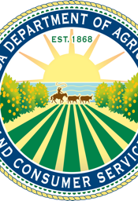
FDACS website for all questions!
Cottage Foods / Food Establishments / Food / Business Services / Home - Florida Department of Agriculture & Consumer Services (fdacs.gov)
Collier County for Local Codes
(239) 252-8192

