Slide 1
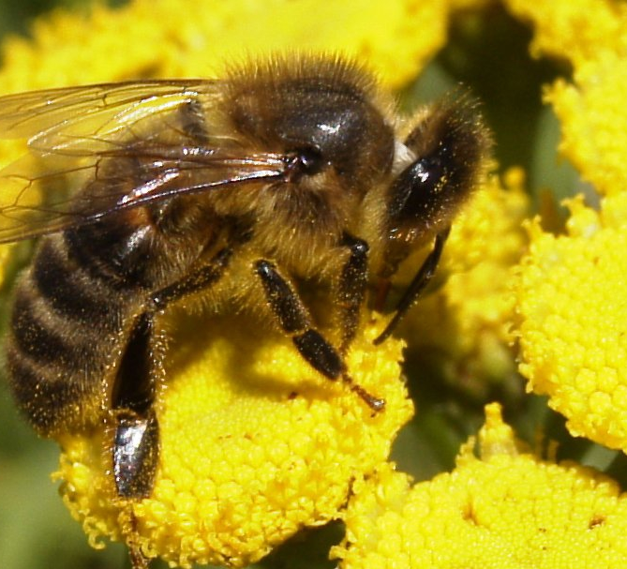
Apiculture
Insects (Class Insecta)

Slide 2
Genetic Traits of Races
Color
Temperament
Handling Ease
Production
Swarming Tendency
Winter Hardiness
Propolizing
Disease Resistance
Fecundity – Reproductive Rate
Cleanliness
Population of Hive
Pollen Hoarding
Honey Hoarding
Conservation of stores
Plant preference
Tongue Length
Whiteness of Cappings

Slide 3
Honey Bee Races
Honey Bees vary in traits such as disease resistance, temperament, and productivity depending on their breed.
New beekeepers often look for gentile temperament as their most desired trait.
The environment has a large effect on differences among bee colonies.

Slide 4
Races of species Apis mellifera
A mellifera mellifera – German
A mellifera ligustica – Italian
A mellifera carnica – Carniolan - Yugoslavia
A mellifera caucasca – Caucasian – Caucasus
A mellifera scutellata – African
Hybrids
Buckfast
Minnesota Hygenic

Slide 5
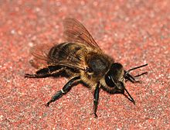
German- Apis mellifera mellifera
“Black” bee
Very dark in color and tends to be very defensive.
Able to survive long, cold winters in northern climates.
Prone to diseases
Rare stock at this time

Slide 6
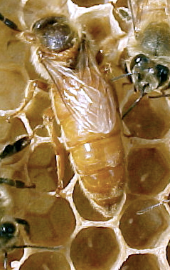
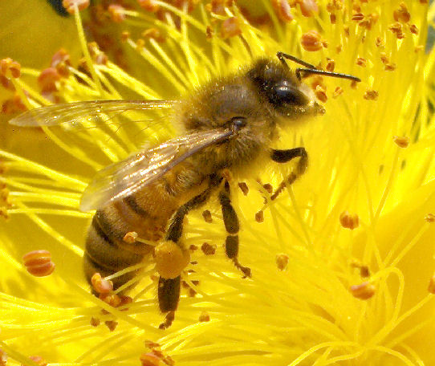
Italian – Apis mellifera ligustica
Brought to the United States in 1859
Very good honey producers
Usually gentle and non-aggressive
Swarming instinct is not especially strong
Minimum propolis
Keep a clean hive and are quick to get rid of the wax moth
They are less defensive and less prone to disease.
Excellent honey producers
Notorious kleptoparasites

Slide 7
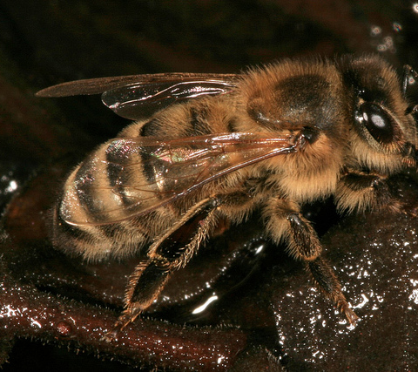
Carniolan – Apis mellifera carnica
From middle Europe (Slovenia Region)
Also has been a favored bee stock in the U.S.
Explosive spring buildup
Extremely docile
Workers live up to 12% longer than other breeds
Less prone to robbing other colonies of honey
Good builders of wax combs
Have a high propensity to swarm

Slide 8
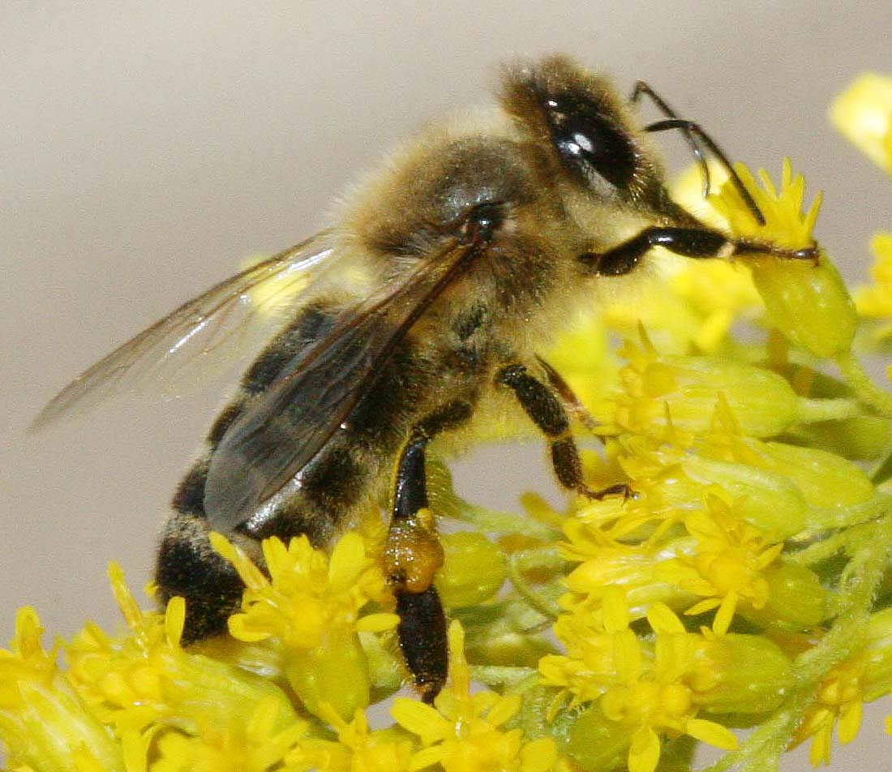
Caucasian- Apis mellifera caucasica
Native to the foothills of the Ural Mountains near the Caspian Sea in Eastern Europe.
Very long proboscis.
Moderately dark colored and extremely docile.
Slow spring buildup keeps them from generating very large honey crops.
Use an excessive amount of propolis.

Slide 9
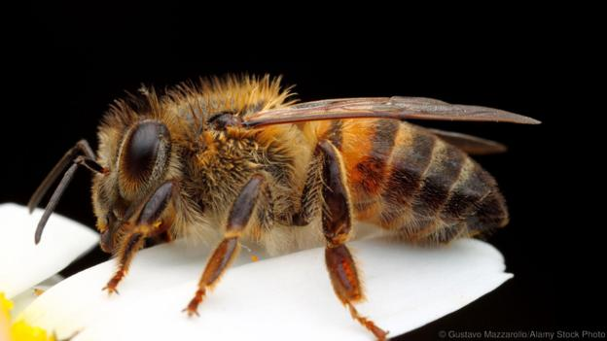
African- Apis mellifera scutellata
Imported into South America in 1956
Highly defensive – aggressive
Well adapted to the tropics
Grow the colony rapidly and swarm often

Slide 10
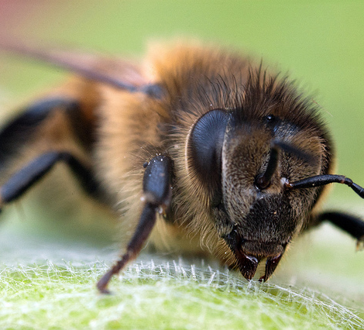
Buckfast
Created by Brother Adams, a monk at Buckfast Abby in Devon, England.
Thrive in cold wet conditions
Produce good honey crop and exhibit good housecleaning and grooming behavior.
Moderately defensive
Moderate in spring population buildup.

Slide 11
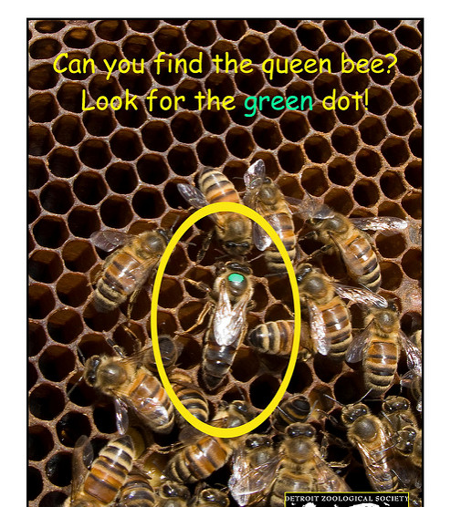
Russian
One of the newer bee stocks in the U.S.
From the Primorski region of the Sea of Japan.
Evolved resistance to varroa mites and exhibit good housecleaning behavior
Rear brood only during times of nectar and pollen flows
High tendency to swarm
Better when not combined with other races.

Slide 12
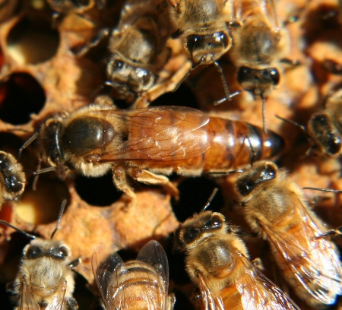
Minnessota Hygenic
A result of the work of Dr. Marla Spivak of the University of Minnesota
Good honey producers and more able to resist American Foul Brood disease

Slide 13
Bee Biology Basics
Honey bees belong to the order Hymenoptera, which includes other bees, wasps and ants.
Two pairs of clear wings, and chewing mouth parts. Some can suck up liquids such as the honey bee.
Undergo complete metamorphosis during their development.

Slide 14
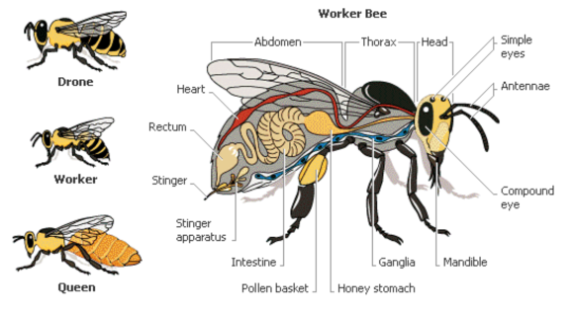
Honey Bee Biology

Slide 15
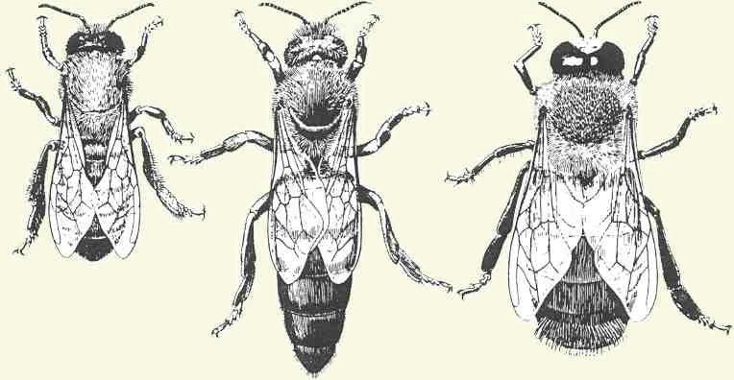
Colonies
Honey bees are social insects that live in highly organized colonies. Each member has a specific job and must work together to survive.
There are three distinct castes of honeybees in a colony: the queen, the worker, and the drone.

Slide 16
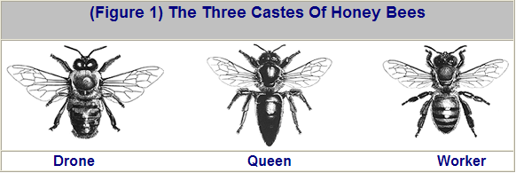
Worker
  Sterile female (Diploid – 32 chromosomes)
Queen
  Mature female (Diploid) only fertile bee in hive
Drone - fatherless
  Male (haploid – 16 chromosomes) [Parthenogenesis]

Slide 17
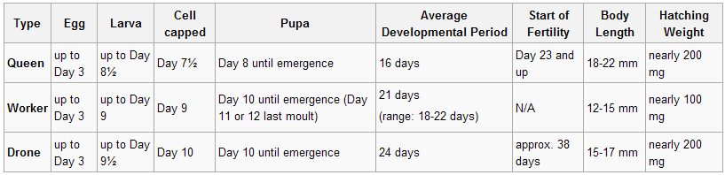
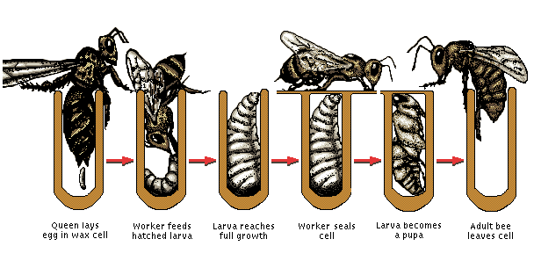
Honey Bee Life Cycle

Slide 18
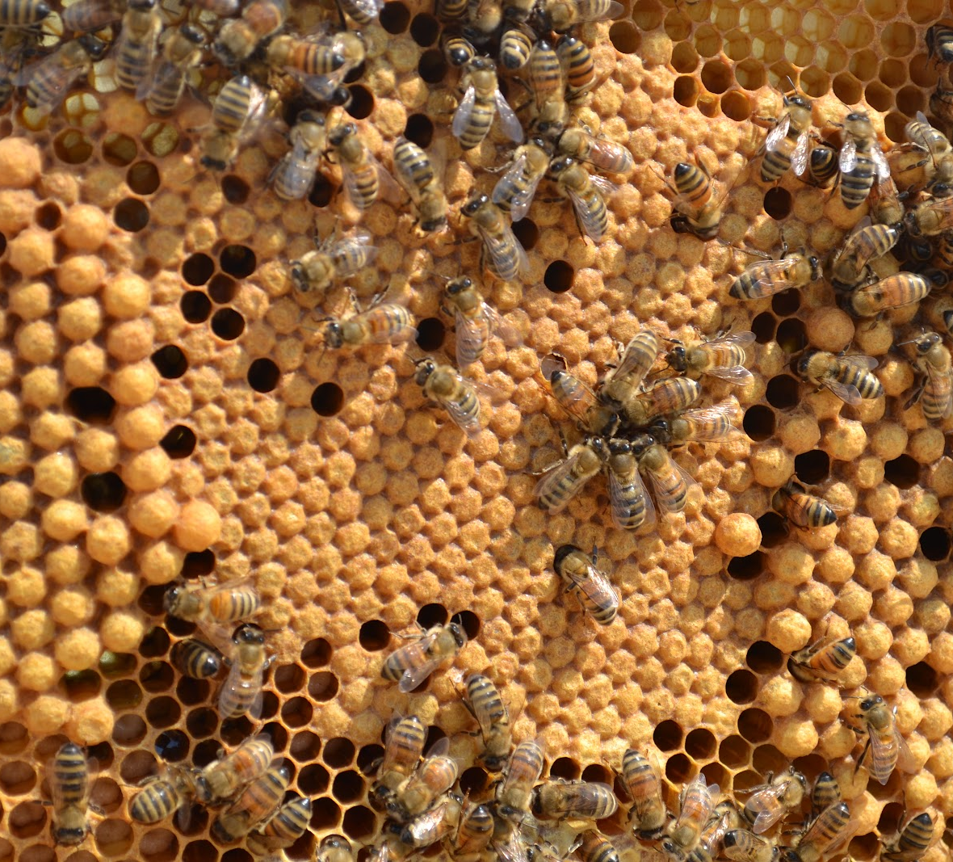
Worker cells and drone cells

Slide 19
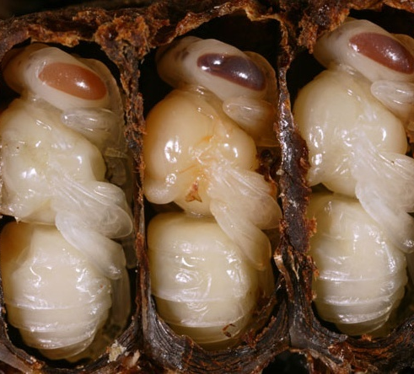
Week Old Nymphs

Slide 20
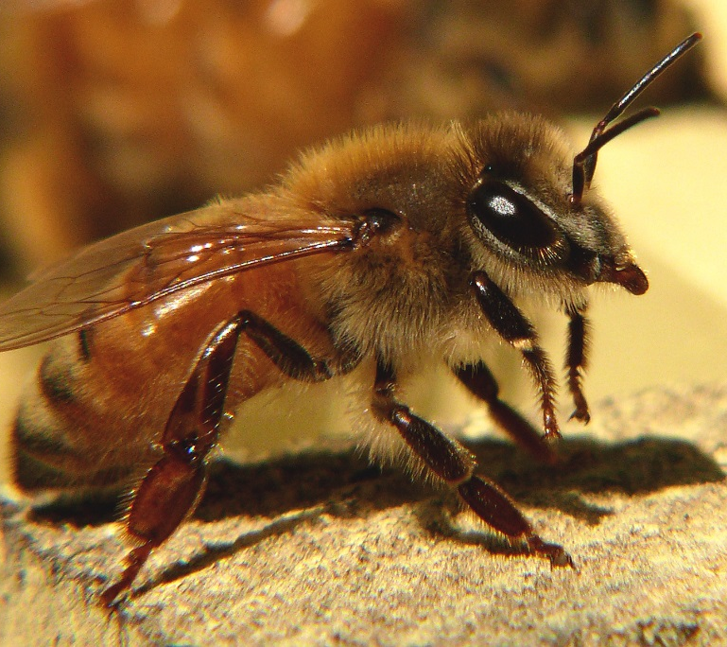
Worker Roles vs. Age
Day 1 – 3 : Cell cleaning and brood incubation
Day 4 – 6 : Feeding older larvae (honey + pollen)
Day 7 – 12 : Feeding young larvae (brood food)
Day 13 – 18 : Processing nectar into honey (water evaporation), wax making, pollen packing
Day 19 – 21 : Guarding hive entrance and orientation flights
Day 21 – 6th week : Foraging for nectar, pollen, water & propolis
Duties as required: Hive ventilation, humidity and temperature control

Slide 21
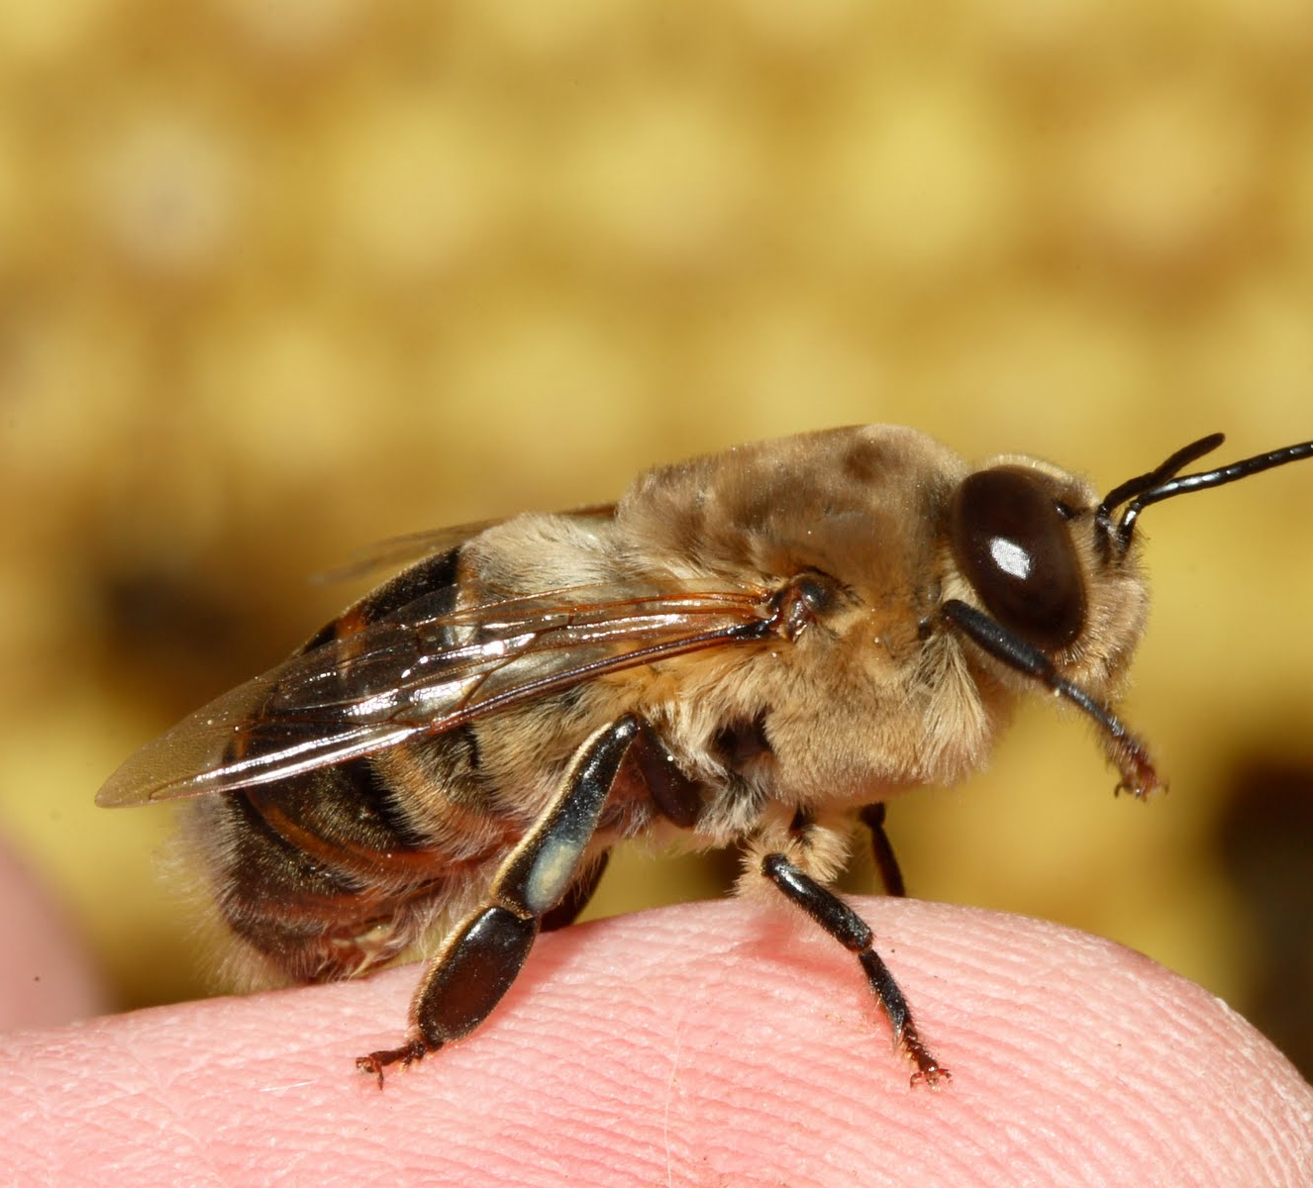
The Drone
Larger than workers, but not as long as queens.
Has large eyes.
Do not have stingers, pollen baskets, or glands for producing wax and their mouth parts are too short to gather nectar.
Their only function is to fertilize new queens, and they die in the process.
Require slightly larger cells and develop from unfertilized eggs.

Slide 22
Drone Roles vs. Age
Day 1 : Eats first honey and pollen meal
> Day 2 : Fed by workers and no longer will eat unaided
< Day 12 : Confined to hive except for cleansing and orientation flights
Day 12 – 14 : Sexually mature
Drones have no stinger
Drones have no hive duties other than to mate
Drones will sometimes imitate guard bees (to increase self esteem)
Drones die upon mating
Drones are killed by workers in autumn to conserve honey and pollen stores

Slide 23
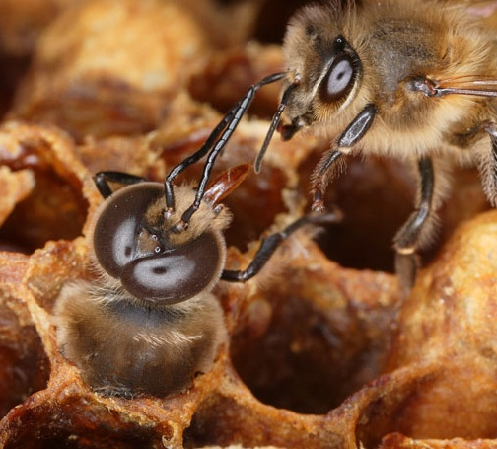
Drone Emergence

Slide 24
The Queen
The queen is the longest bee in the hive, but has the shortest wings.
She is the mother of all the bees in her hive.
Her job is to lay eggs, her productivity is influenced by the amount of food available, empty brood space, temperature and more.
Her workers recognize her mostly by the smell of her pheromones.

Slide 25
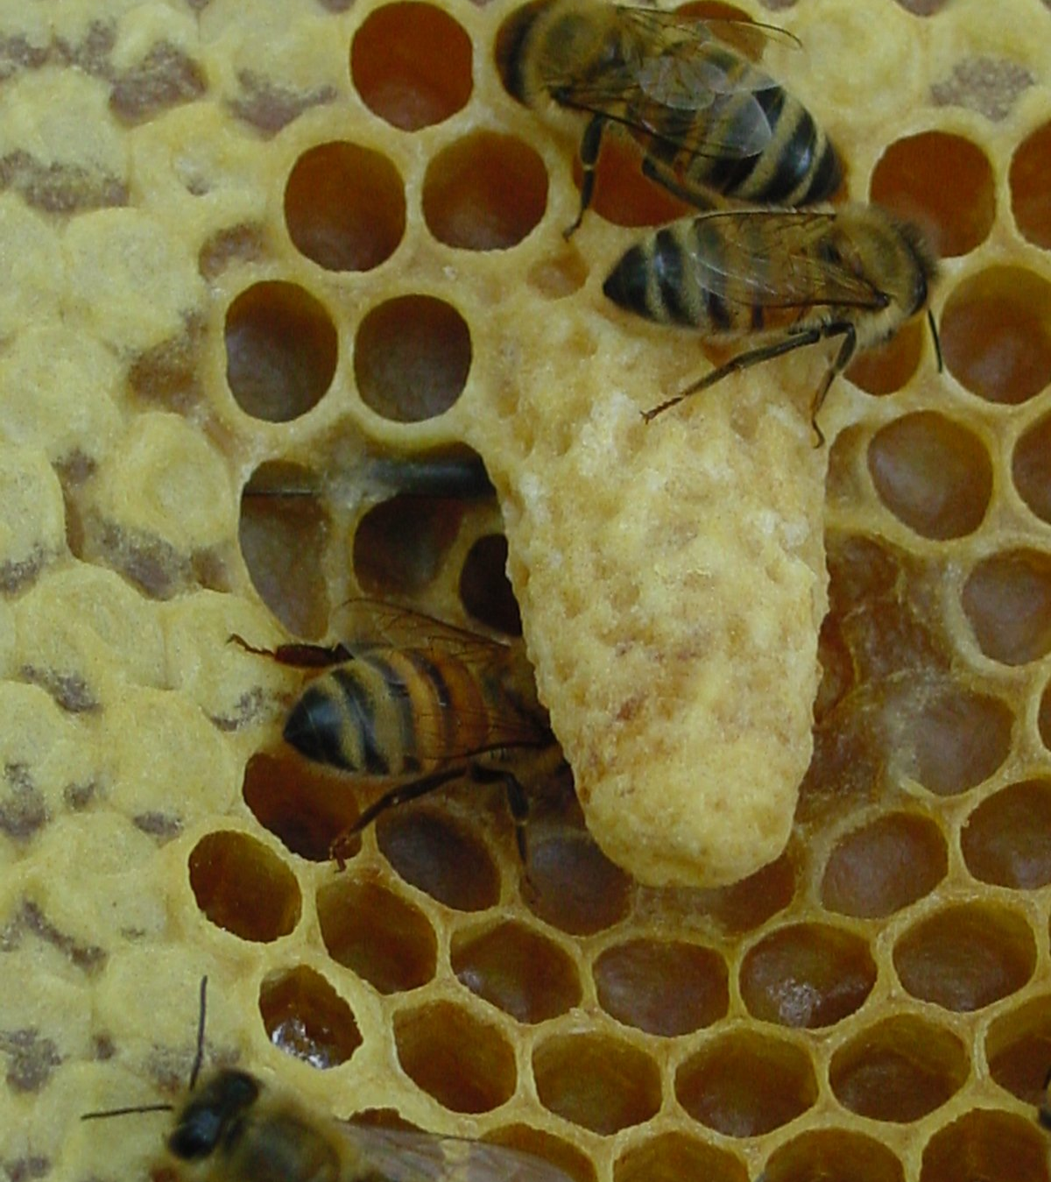
Queen Cells
Look like round balls attached to comb.
Queen cells must be monitored to prevent swarming
Worker bees make new queens for one of three reasons:
  The former queen left with a swarm.
  The queen is laying increasingly fewer eggs.
  The colony is overcrowded and has no place to expand.

Slide 26
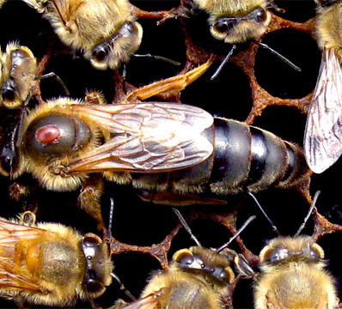
Queen Roles vs. Age
Day 1 : First queen to hatch finds and kills other sealed and unsealed queens
Day 3 – 5: Orientation flights
Day 7 – 21 : Mating flights
Begins laying 2 – 4 days after mating
Produces pheromones to alert workers of her presence
Can live up to 5 years (usually only 3 years)
Able to lay 1500 eggs/day (during peak nectar flow)
Stores sperm from all mating flights in spermetheca (sperm sack)
Killed by workers when can no longer lay fertile eggs
Can decide whether to lay fertilized or un-fertilized eggs
Fed, groomed, and protected by worker attendants
  .

